Slide 1
INTEGRATED MULTIMEDIA MESSAGE STANDARDS
SHRIHARI BH
20IT48

Slide 2
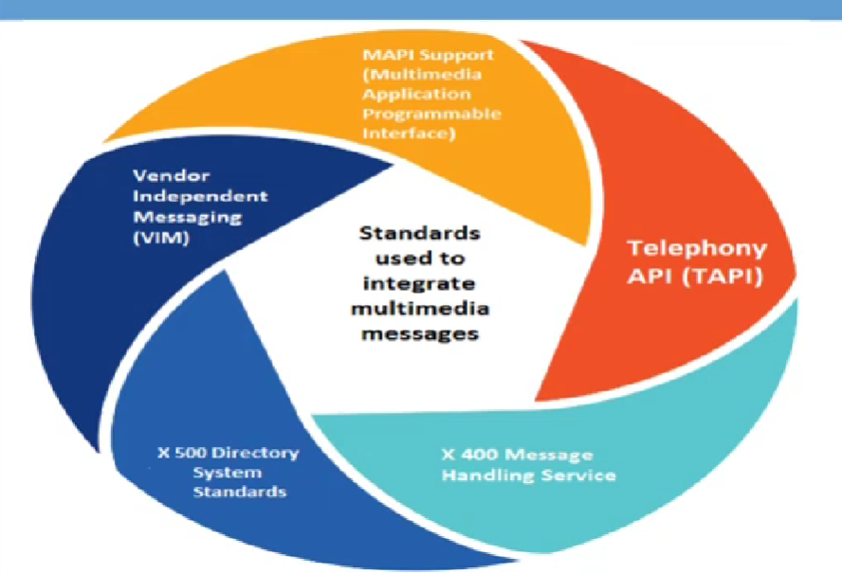
Types of Standards

Slide 3
VENDOR INDEPENDENT MESSAGING(VIM)
VIM interface is designed to facilitate messaging between VIM –enabled electronic mail System
The VIM Interface is Implemented as an Application Programming Interface (API) for Messaging System
The VIM interface Makes mail and Messaging Service available through a well defined Interface
A Message service enable its clients to Communicate with each other in a store and forward manner

Slide 4
VENDOR INDEPENDENT MESSAGING(VIM)
VIM defines messaging as the data exchange mechanism between VIM aware applications
Messages are Delivered to a Message Container each VIM aware Application is Associated with the Container and has Access to one or more Message Containers
VIM aware Application use one or more address books
Apart from user Information, address books contain the location of the message containers for each user

Slide 5
VIM Messages
The Objects Transported by a Messaging System are Called Messages
The Message along with the address is sent to messaging system
The Messaging System that Provide service accepts the Responsibility for Routing and Delivering the Message to the Message Container of the Recipient
When the Recipient Application learn that it has new messages in the message container, it uses its VIM interface to read the message form the message containers
The recipient can delete the message store it in the message container or in some other application

Slide 6
Messages Definition
Each Message has a message type associated with it
The Message type defines the Syntax of the message and the type of information that can be contained in the message
A VIM Message Consists of a Message Header the recipient address originated ,time/date priority and so on
VIM also Allows nesting of Message , i.e. one Message can be enclosed in another message.

Slide 7
Mail Messages
A Mail Message is a Message of a well defined type that must include a message header
It may also include note parts, attachments and other application definer components
E.g. Parts may include text , bitmaps(array of bits specify color of each pixel), picture, sound and video components

Slide 8
Message Delivery
On Successful delivery of a message, a deliver report is generated and sent to the sender of the message if the sender requests a delivery report
If a message cannot be delivered to the recipient, a non delivery is sent to the sender
A Message delivered to a Message Container remain Marker unread until an Application calls VIM open message() to open it.

Slide 9
Message Container
Each VIM Messaging client has access to one or more messages Containers
VIM grants Access to Message Containers when a user or an Application is authenticated and a session is opened
Multiple Users or applications can access one message Container
Each Message in a Container has a reference number associated with it => as long as the message remain stored in the message container

Slide 10
MAPI Support(Multimedia Application Program Interface)
Access to Discovery services and Multimedia Resources
Multimedia Resources Delivery Services for Files and Streams
Access to Metadata Resources, Media Resources and Information
Authentication Services, Key Management Services, Encryption Services and Decryption Services
Coding, Transcoding, Filtering, Composition, Splitting and Concatenation of Media Resources
Management of Multimedia Resources link Moving Copying, Backup and Restore of Multimedia Resources

Slide 11
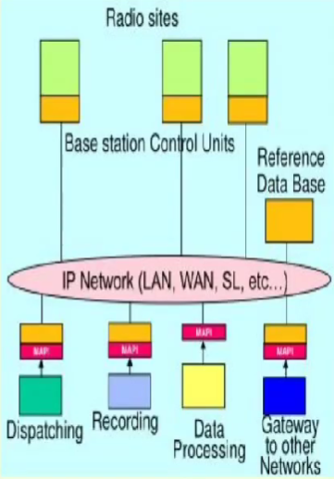
MAPI Support
MAPI Provide Intermediate layer Between Applications and Messaging System
The Primary goals of MAPI are: Separate client applications from the Underlying Messaging Services

Slide 12
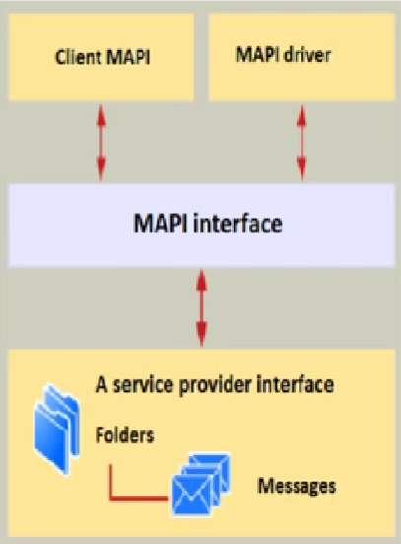
MAPI Architecture
Client APII : Provide the Link Between the Client Application
Service Provider : Interface Links MAPI to the Messaging System
MAPI Driver are Provided by Microsoft

Slide 13
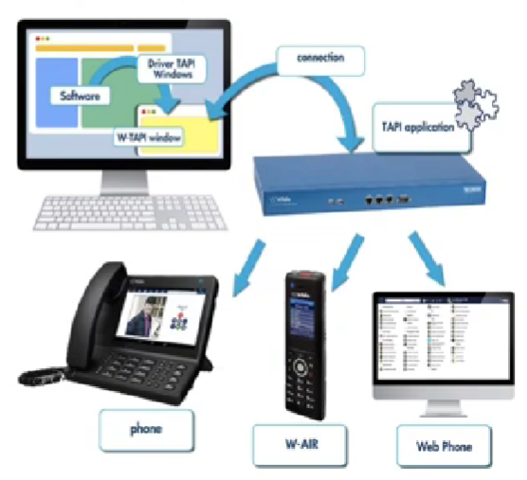
Telephony API (TAPI)

Slide 14
Functions of TAPI
TAPI is Used Primarily to Control on Modems
Allow Text Message to emails, phones call to video and Intelligent chat bots
TAPI Allow Applications to Control telephony functions between a computer and telephony network for data, fax and voice calls
Basic Functions such as dialling, answering and hanging up a call
Support Supplementary Function, Such as hold, transfer and Conference
TAPI can also be used to Control voice-enabled telephony devices

Slide 15
X400 Message Handling Service
X.400 is a suite of ITU-T(International Telegraph Union-Telecommunication)Recommendations that defines the ITU-T Message Handling System(MHS)
X.400 address-Referred to ad an Originator address
Purposes:
Mailbox Identification – either the originator or recipient
Global domain Identification – where a given mailbox is located
X.400 address – Indetified where the user is located

Slide 16
FUNCTIONS
The MHS Provide end User to send and receive electronic Message
End user is an Originator => composes and sends Message
Receiver receive Message
A User Agent(UA) Provide the function for end user
They Provide storage of mail, sorting directories and forwarding)process
Message Transfer Agent(MTA) forwards Message from the originator UA to Another MTA
Number of MTA are combine to form Message Transfer System(MTS)

Slide 17
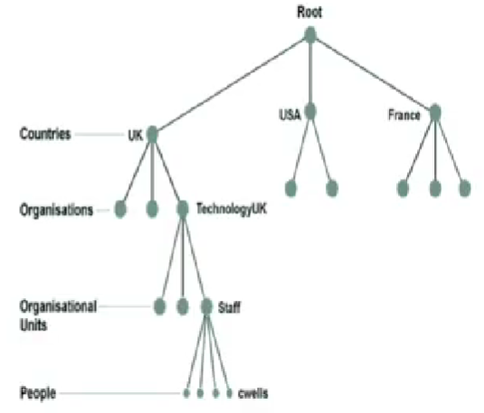
X.500 Directory System Standards
X.500 is the most common directory management protocol
Uses a hierarchical approach to objects in the nasespaces

Slide 18
Integrated Document Management
One of the key technologies of work group computing is a class of application and functionality called middleware, which integrates library services and document creation
Interchange is Designed to Support critical business process application around a client server topology using open application interface

Slide 19
Integrated Document Management for Messaging
Specialized Messaging System such as notes provide integrated document management for messaging
This means that the user can attach, embed, or link a Varity of multimedia objects such as graphics, images, audio, and video to the document
When a document is forwarded to other users, all the associated multimedia objects are also forwarded and available to the new recipient

Slide 20
Multimedia Object Server and Mail Server Interactions
The Mail server is used to store all emails messages
It Consists of a file server with mail files for each user recipient who use that server as the mail box
The users can review the mail and deleted mail no longer required from this file
The Link Information can be in the form of Paths name, or an object ID
An Object ID may be a structure with various attributes in it

Slide 21
THANK YOU

